Slide 1
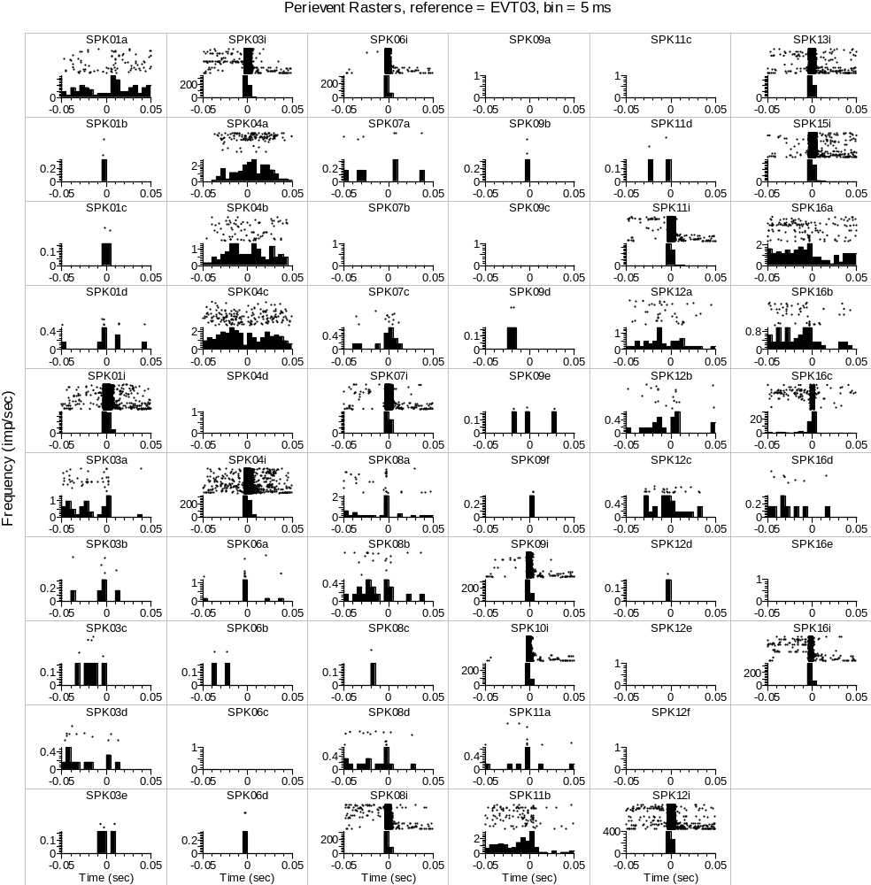
CeA CRF OA3-3_10202017_EtOH_FULL DID SESS-DID1_002.pl2: Perievent Rasters
Analysis Type = Perievent Rasters
Ref. Type = Fixed
Reference = EVT03
XMin (sec) = -0.05
XMax (sec) = 0.05
Trial Order = First On Top
Sort Trials = None
Sort Event = First after reference
Sort Ref. = EVT03
Histogram = Below
Hist. Height(%) = 45
Bin (sec) = 0.005
Normalization = Spikes/Sec
No Selfcount = 1
Select Data = All
Select Data From (sec) = 0
Select Data To (sec) = 1658.584275
Int. Filter Type = Fixed
Interval Filter = None
Create Filter on-the-fly = 0
Create Filter around = EVT03
Start Offset (sec) = 0
End Offset (sec) = 1
Fix Overlaps = 1
Smooth Histogram = None
Sm. Width = 3
Add Bin Left to Results = 0
Add Bin Middle to Results = 0
Add Bin Right to Results = 0
Run Postproc. Script = 0
Postprocessing Script =
Postproc. Script Parameter =
Data File: D:\Users\Sonia Aroni\Dropbox (Sparta Lab)\Electrophysiology Data Backup\CeA CRF OA Batch3 - DID Ephys\CeA CRF OA3-3_10202017_EtOH\Split Files\CeA CRF OA3-3_10202017_EtOH_FULL DID SESS-DID1_002.pl2
November 02, 2017 14:43:48

Slide 2
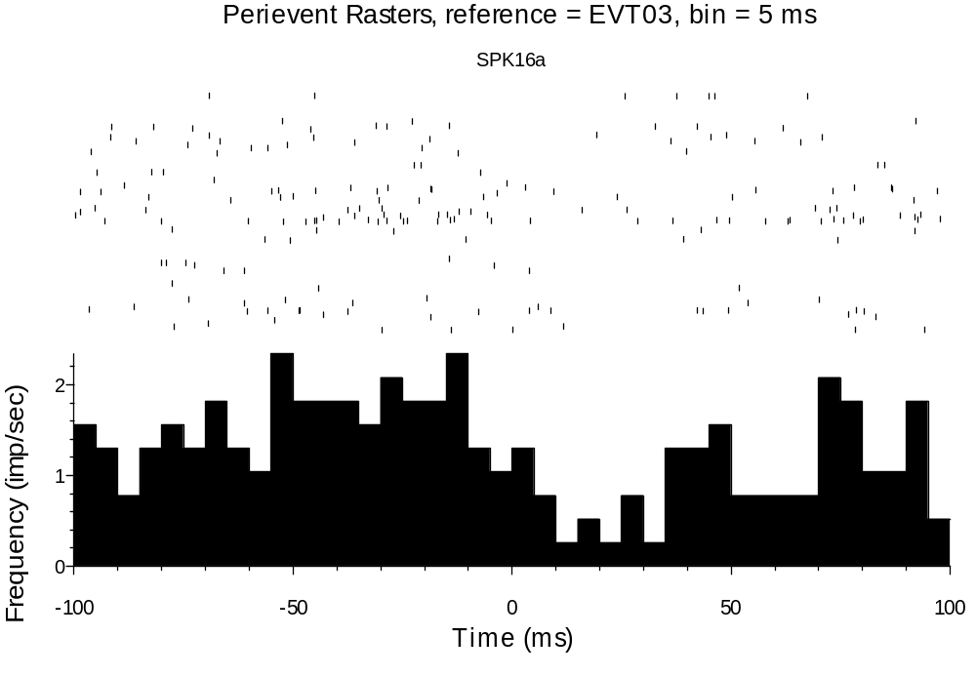
CeA CRF OA3-3_10202017_EtOH_FULL DID SESS-DID1_002.pl2: Perievent Rasters
Analysis Type = Perievent Rasters
Ref. Type = Fixed
Reference = EVT03
XMin (sec) = -0.1
XMax (sec) = 0.1
Trial Order = First On Top
Sort Trials = None
Sort Event = First after reference
Sort Ref. = EVT02
Histogram = Below
Hist. Height(%) = 45
Bin (sec) = 0.005
Normalization = Spikes/Sec
No Selfcount = 1
Select Data = From Time Range
Select Data From (sec) = 0
Select Data To (sec) = 12335.582205375
Int. Filter Type = Fixed
Interval Filter = None
Create Filter on-the-fly = 0
Create Filter around = EVT02
Start Offset (sec) = 0
End Offset (sec) = 1
Fix Overlaps = 1
Smooth Histogram = None
Sm. Width = 3
Add Bin Left to Results = 0
Add Bin Middle to Results = 0
Add Bin Right to Results = 0
Run Postproc. Script = 0
Postprocessing Script =
Postproc. Script Parameter =
Data File: D:\Users\James\Dropbox (Sparta Lab)\Electrophysiology Data Backup\CeA CRF OA Batch3 - DID Ephys\CeA CRF OA3-3_10202017_EtOH\Split Files\CeA CRF OA3-3_10202017_EtOH_FULL DID SESS-DID1_002.pl2
November 06, 2017 15:57:16

Slide 3
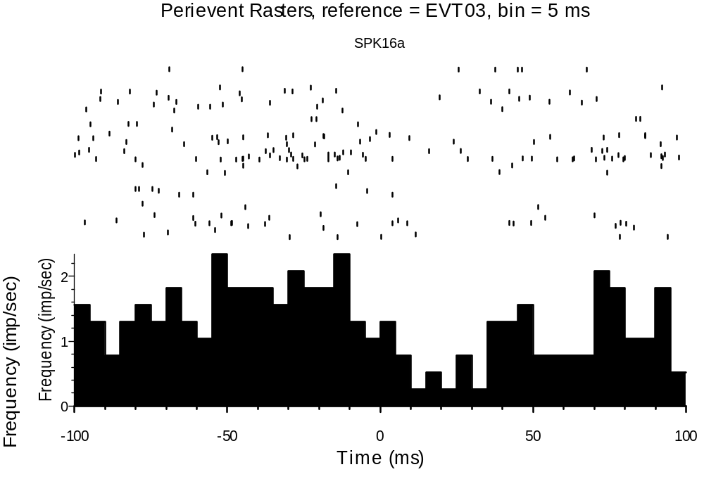
CeA CRF OA3-3_10202017_EtOH_FULL DID SESS-DID1_002.pl2: Perievent Rasters
Analysis Type = Perievent Rasters
Ref. Type = Fixed
Reference = EVT03
XMin (sec) = -0.1
XMax (sec) = 0.1
Trial Order = First On Top
Sort Trials = None
Sort Event = First after reference
Sort Ref. = EVT02
Histogram = Below
Hist. Height(%) = 45
Bin (sec) = 0.005
Normalization = Spikes/Sec
No Selfcount = 1
Select Data = From Time Range
Select Data From (sec) = 0
Select Data To (sec) = 12335.582205375
Int. Filter Type = Fixed
Interval Filter = None
Create Filter on-the-fly = 0
Create Filter around = EVT02
Start Offset (sec) = 0
End Offset (sec) = 1
Fix Overlaps = 1
Smooth Histogram = None
Sm. Width = 3
Add Bin Left to Results = 0
Add Bin Middle to Results = 0
Add Bin Right to Results = 0
Run Postproc. Script = 0
Postprocessing Script =
Postproc. Script Parameter =
Data File: D:\Users\James\Dropbox (Sparta Lab)\Electrophysiology Data Backup\CeA CRF OA Batch3 - DID Ephys\CeA CRF OA3-3_10202017_EtOH\Split Files\CeA CRF OA3-3_10202017_EtOH_FULL DID SESS-DID1_002.pl2
November 06, 2017 16:01:01

Slide 4
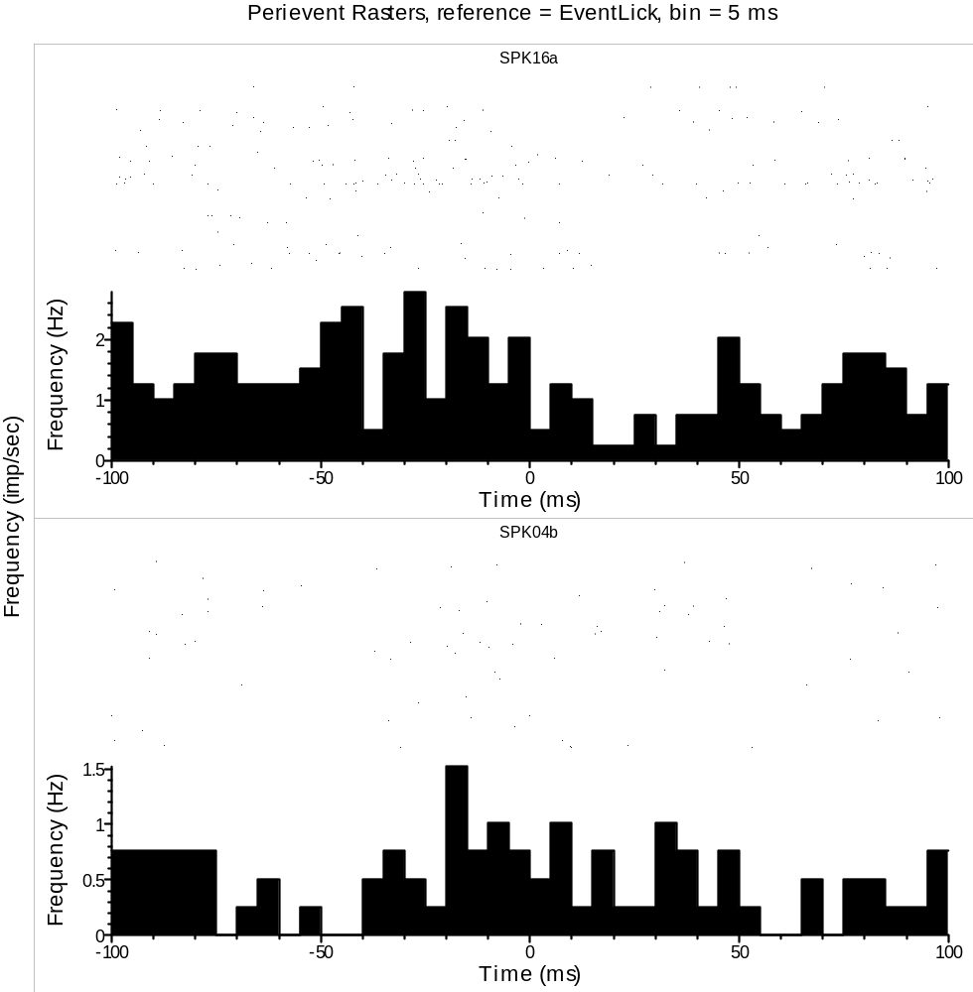
CeA CRF OA3-3_10202017_EtOH_FULL DID SESS-DID1_002.pl2: Perievent Rasters
Analysis Type = Perievent Rasters
Ref. Type = Fixed
Reference = EventLick
XMin (sec) = -0.1
XMax (sec) = 0.1
Trial Order = First On Top
Sort Trials = None
Sort Event = First after reference
Sort Ref. = EVT02
Histogram = Below
Hist. Height(%) = 45
Bin (sec) = 0.005
Normalization = Spikes/Sec
No Selfcount = 1
Select Data = From Time Range
Select Data From (sec) = 0
Select Data To (sec) = 13053.916172325
Int. Filter Type = Fixed
Interval Filter = None
Create Filter on-the-fly = 0
Create Filter around = EVT02
Start Offset (sec) = 0
End Offset (sec) = 1
Fix Overlaps = 1
Smooth Histogram = None
Sm. Width = 3
Add Bin Left to Results = 0
Add Bin Middle to Results = 0
Add Bin Right to Results = 0
Run Postproc. Script = 0
Postprocessing Script =
Postproc. Script Parameter =
16a is lick inhibhitex
Data File: D:\Users\James\Dropbox (Sparta Lab)\Electrophysiology Data Backup\CeA CRF OA Batch3 - DID Ephys\CeA CRF OA3-3_10202017_EtOH\Split Files\CeA CRF OA3-3_10202017_EtOH_FULL DID SESS-DID1_002.pl2
November 06, 2017 20:34:19

